Slide 1
Telecommunications
Basic 12 - Unit 1a - Technology Today

Slide 2
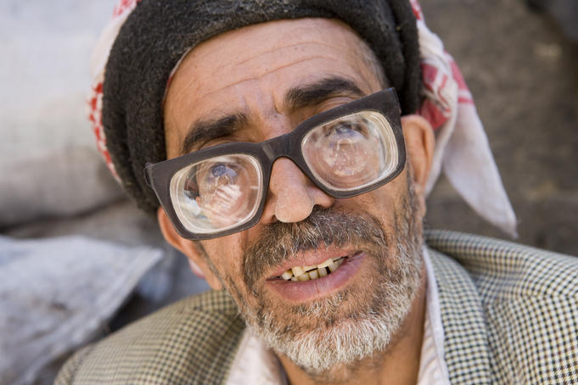
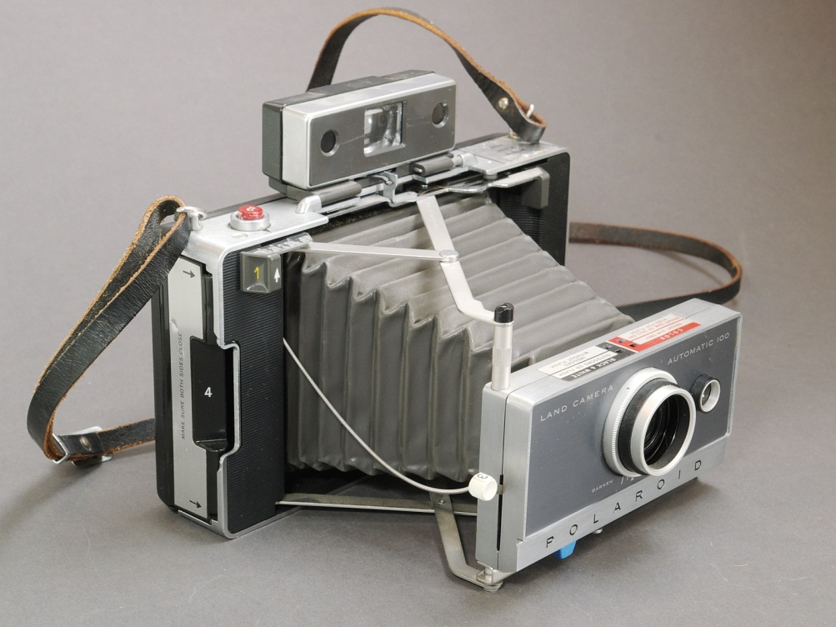

Slide 3
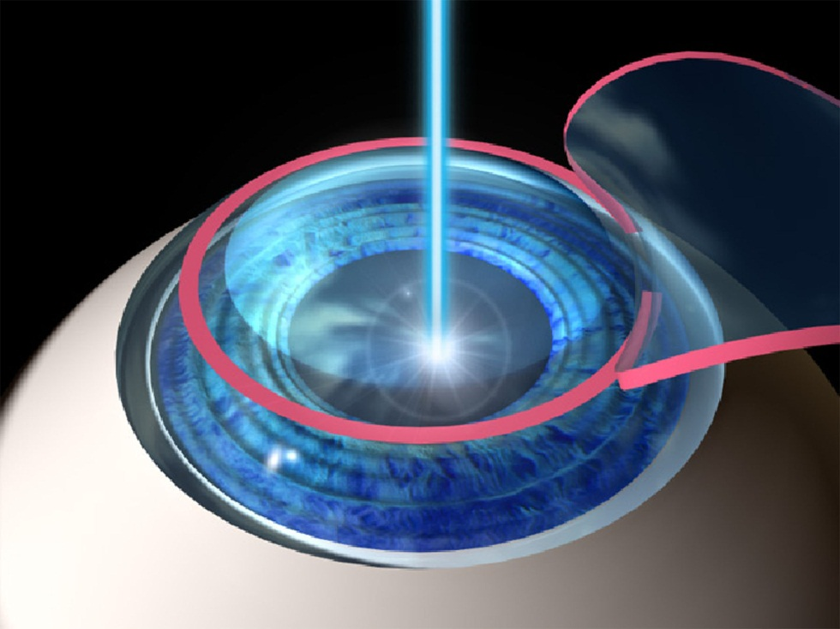
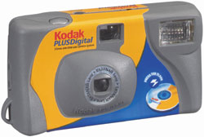

Slide 4
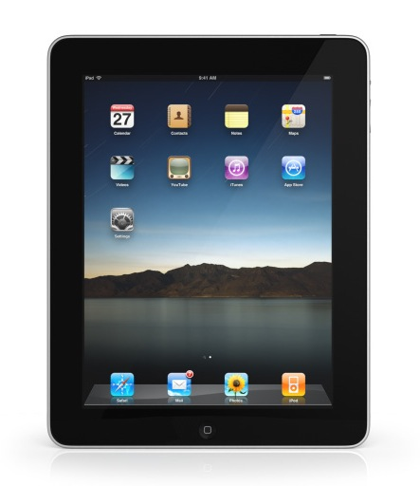
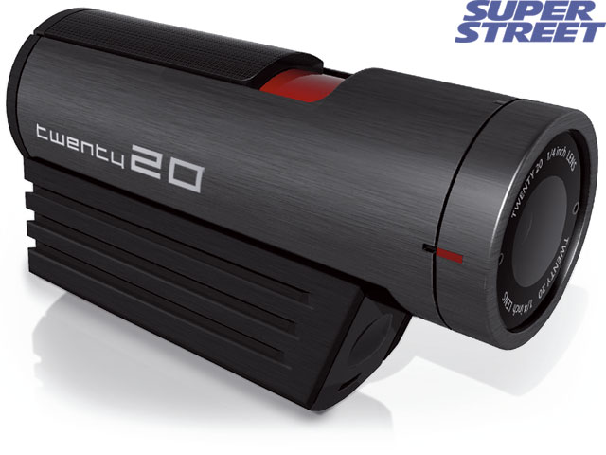
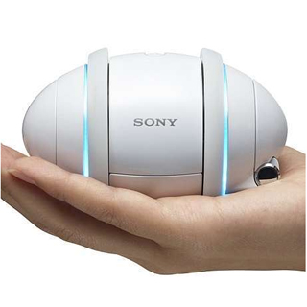
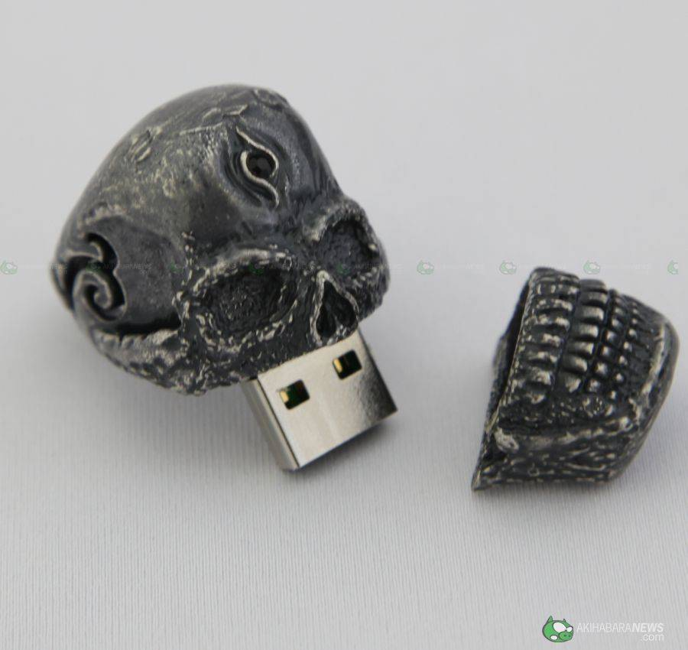
What are these?
How would you describe them?

Slide 5
Complete the sentences
portable
My new camera is very _________, I take it everywhere.
This phone is too expensive, but this one is ____________.
Lala always buys Samsung because they are a _______ brand.
My sister´s dropped her phone 5 times, and it´s still ok. It definetely is __________.
Nowadays, cellphones are very _________, I can use them for almost everything.
I bought _______ dishes for the party. I hate washing dishes.
affordable
reliable
durable
convenient
disposable

